Slide 1

Democratizing Interior Design
VisCommerce

Slide 2
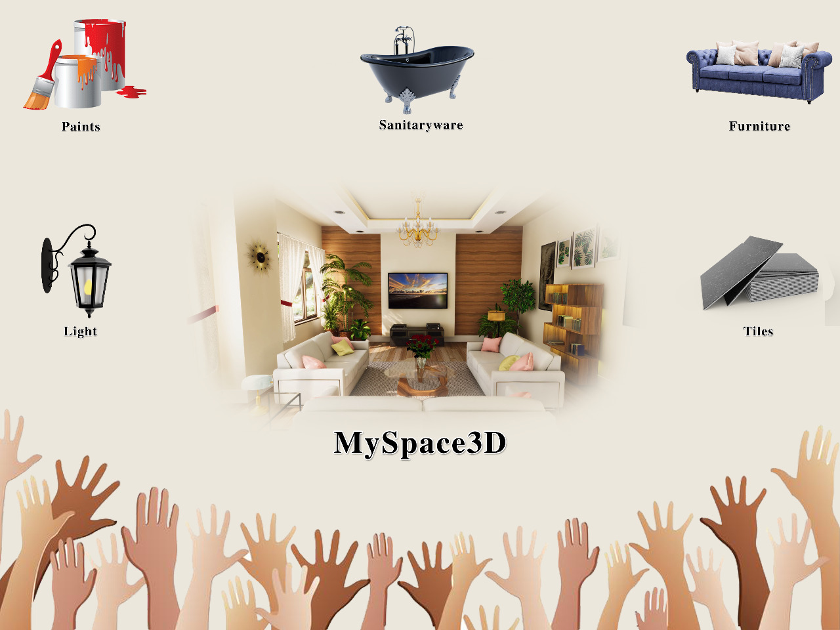

Slide 3
# 1 – Establish expertise the right way
Market
Real estate - Size, Growth trends (India, USA, World)
Home décor – Size, Growth, Trends (India, USA, World)
Interior Design Market – Size, Growth, Trends (India, USA, World)
Pie-Chart showing un-addressed market
Consumers (home owners etc)
Simulation or “Try-n-Buy” approach saves time & money
Vendors
Lighting, Paints, Tiles, Furniture, Sanitaryware
Benefits
Shop-The-Look Enables bulk sale
Large renovation market
Offers new revenue streams via rendered images/videos
Industry Trends in Engineering
Civil Engineering – Autodesk etc.
Mechanical Engineering – Solidworks etc
Electronics Engineering – Synopsys etc

Slide 4
# 1 – Establish expertise the right way (cont’d)
Unit Economics
Cost of a 4 bhk house – $ 1 million
Spend in Interiors - $ 150,000 (15%)
Spend on Interior-Design - $ 15,000 (1.5%)
Spend on 3D Model, Rendered Images and Videos -$ 1000 (0.1%)
Mattrei – Please research and verify these numbers

Slide 5
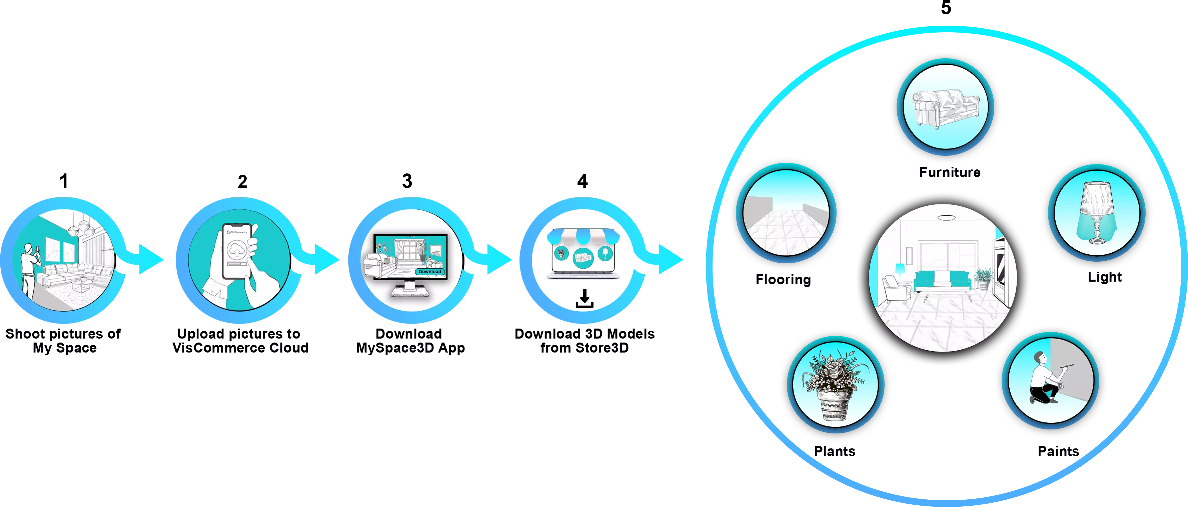
# 2 – Trust is a brick wall
Describe steps 1 – 5

Slide 6

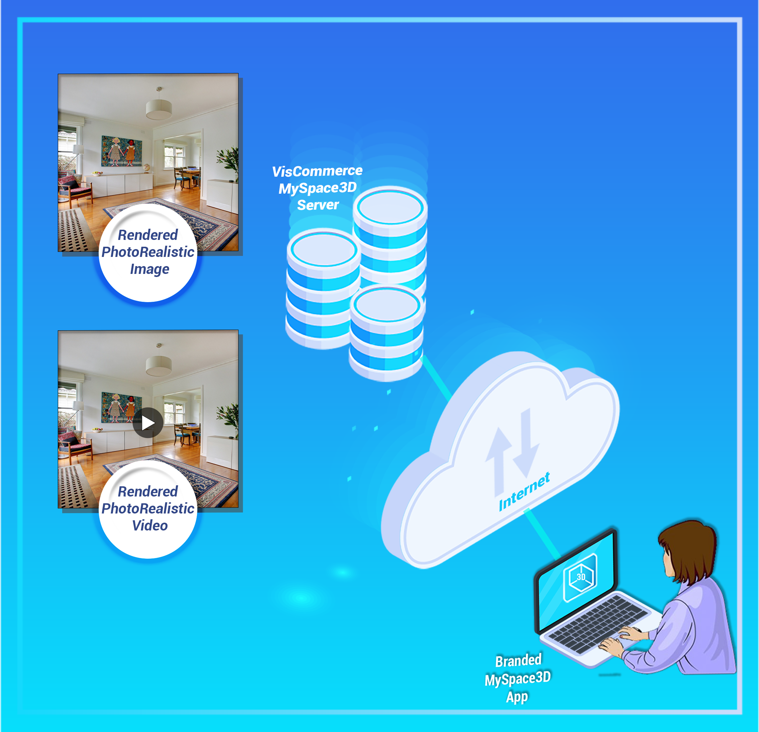
# 2 – Trust is a brick wall
Describe steps 6, 7
Technologies
3D Commerce compliant assets in glTF
Unity based solution on Windows, Android, iOS
AI based 3D Reconstruction for Scale-Accurate model of Customer Space
Demo

Slide 7
# 3 – Give first, and give fast
Stats and Quotes related to Personalization
More than 80% customers prefer personalized solutions

Slide 8
# 4 – Funnel for your life
White Labelling
End Customers of Vendors of Furniture, Lighting, Paints, Tiles, Sanitaryware
Pricing by Vendors
Technology by VisCommerce
Revenue Share arrangements

Slide 9
# 5 Conclusion
Patent pending solution by VisCommerce offers un-precedented power to folks interested in Interior Design. This could range from home-owners to commercial space designers like a Dentist Office etc. This innovation from VisCommerce leverages many leading technologies such as 3D, AI, Blockchain, Crypto and Web-Technologies. It offers new revenue streams, new markets and bulk sales for vendors in the furniture, paints, tiles, lighting, sanitary-ware sectors
For further demos or business enquiries, please drop an email to rk@viscommerce.com

